Slide 1
Stubborn leader.

Slide 2
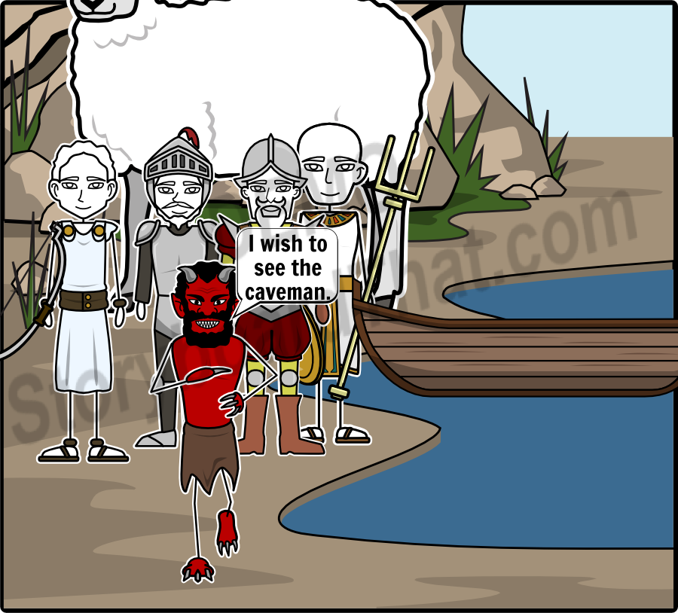
Add Title Here
Add Text Here

Slide 3
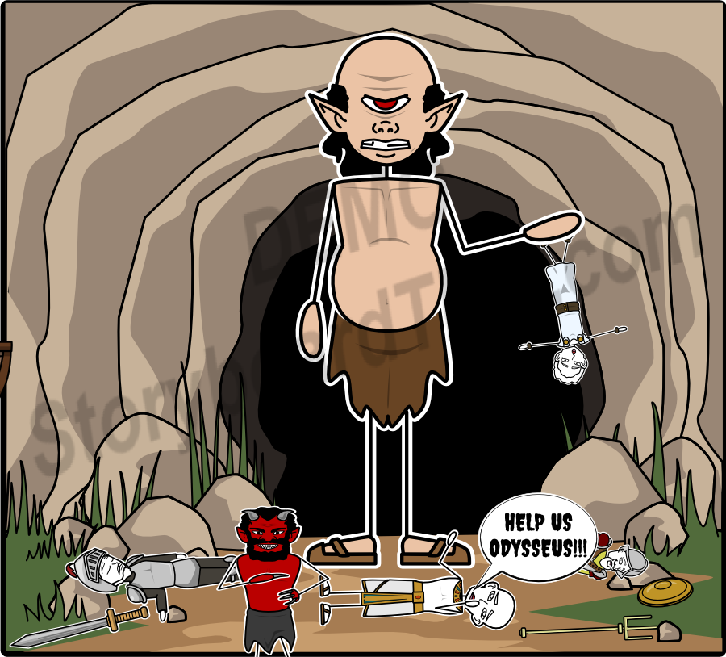
Add Title Here
Add Text Here

Slide 4
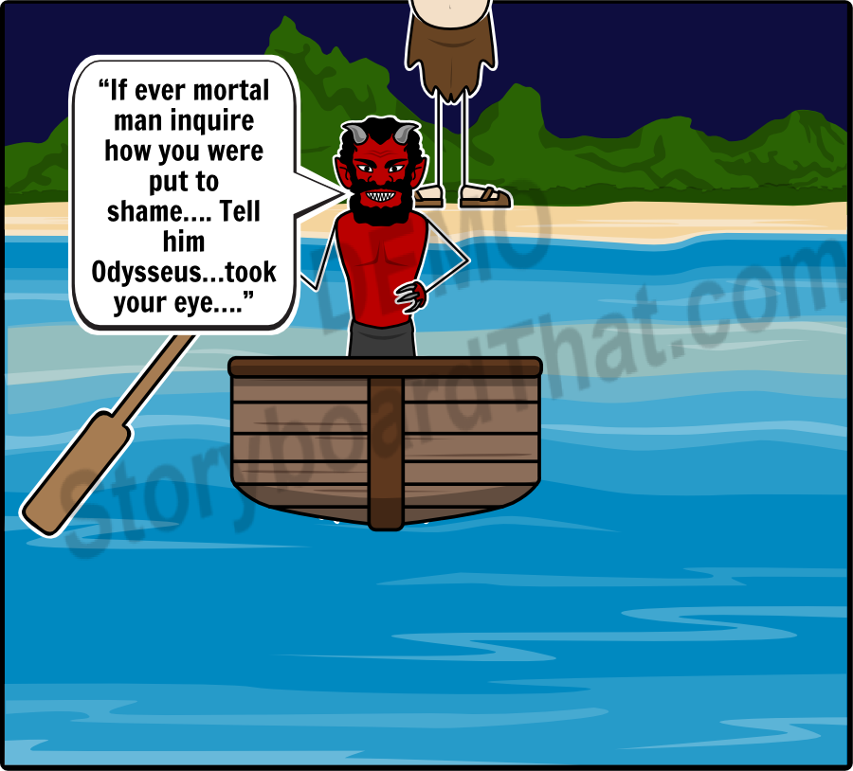
Add Title Here
Add Text Here

